Slide 1
3D Peek Printer
Senior Capstone Design

Slide 2
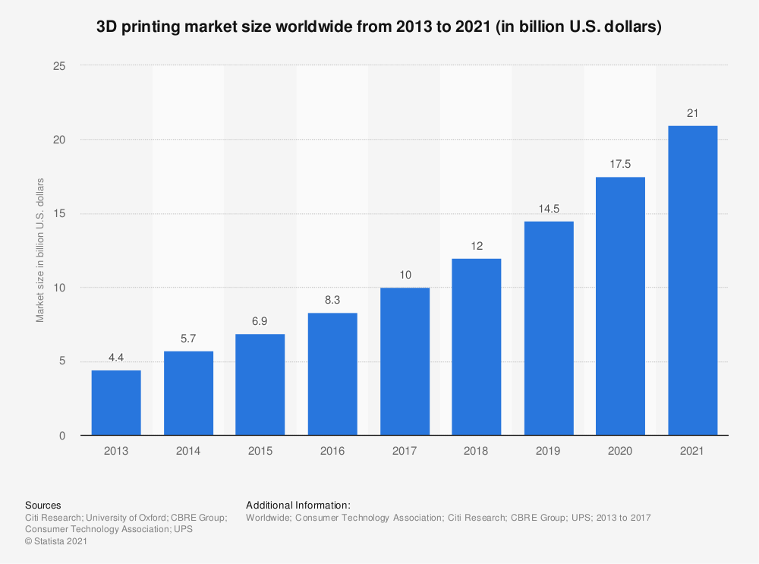
3D Printing Technology
Pros
Low machine cost
Low per-unit print cost
Rapid Production
Low size footprint
Wide availability
High strength
High temperature
Cons
Dimensionally inaccurate
±0.1mm vs ±0.005mm for CNC
Limited object size
Low strength
Low temperature
In 2018, the 3D printing industry was worth 1.5 billion. It is predicted to be worth 3.78 billion by 2026

Slide 3
Market Analysis
 | Max Extruder Temp. | Max Bed Temp. | Max Chamber Temp. | Build Volume | Price
Average Commercial PEEK Printer | 490 | 193 | 165 | 5.01e7 | 61,000
Intamsys Funmat HT | 450 | 160 | 90 | 1.76e7 | 6,000
Aon-M2+ | 450 | 200 | 135 | 1.30e8 | 50,000
3DPP | 450 | 200 | 80 | 1.12e8 | 2,500
Intamsys Funmat HT
10x smaller build volume
Double price
Aon-M2+
Similar build volume
10x price

Slide 4
Design Requirements
Functional Requirements
Respond to movement commands in the X, Y, Z, and extruder directions
Heat nozzle to 450 °C, bed to 200 °C, chamber to 80 °C
Print all common filament types without heated chamber
Can print PEEK/PSU object
Print volume of 300x280x1330mm
Operate at maximum chamber temperature for 3 days continuously
Usability Requirements
System can operate on a local 20A breaker without heated chamber and with a heated chamber on 3 separate 20A circuits
Will have thermal protection for the nozzle, heated bed, and chamber
System will have fused connections in the event of a short
User Experience Requirements
User can monitor and control temperature and movement locally through an LCD
Through a web interface, the user can:
Control nozzle, bed, and chamber temp
Control X, Y, Z, and E movement
Send commands
Start, stop, and monitor prints
View print through real-time stream

Slide 5
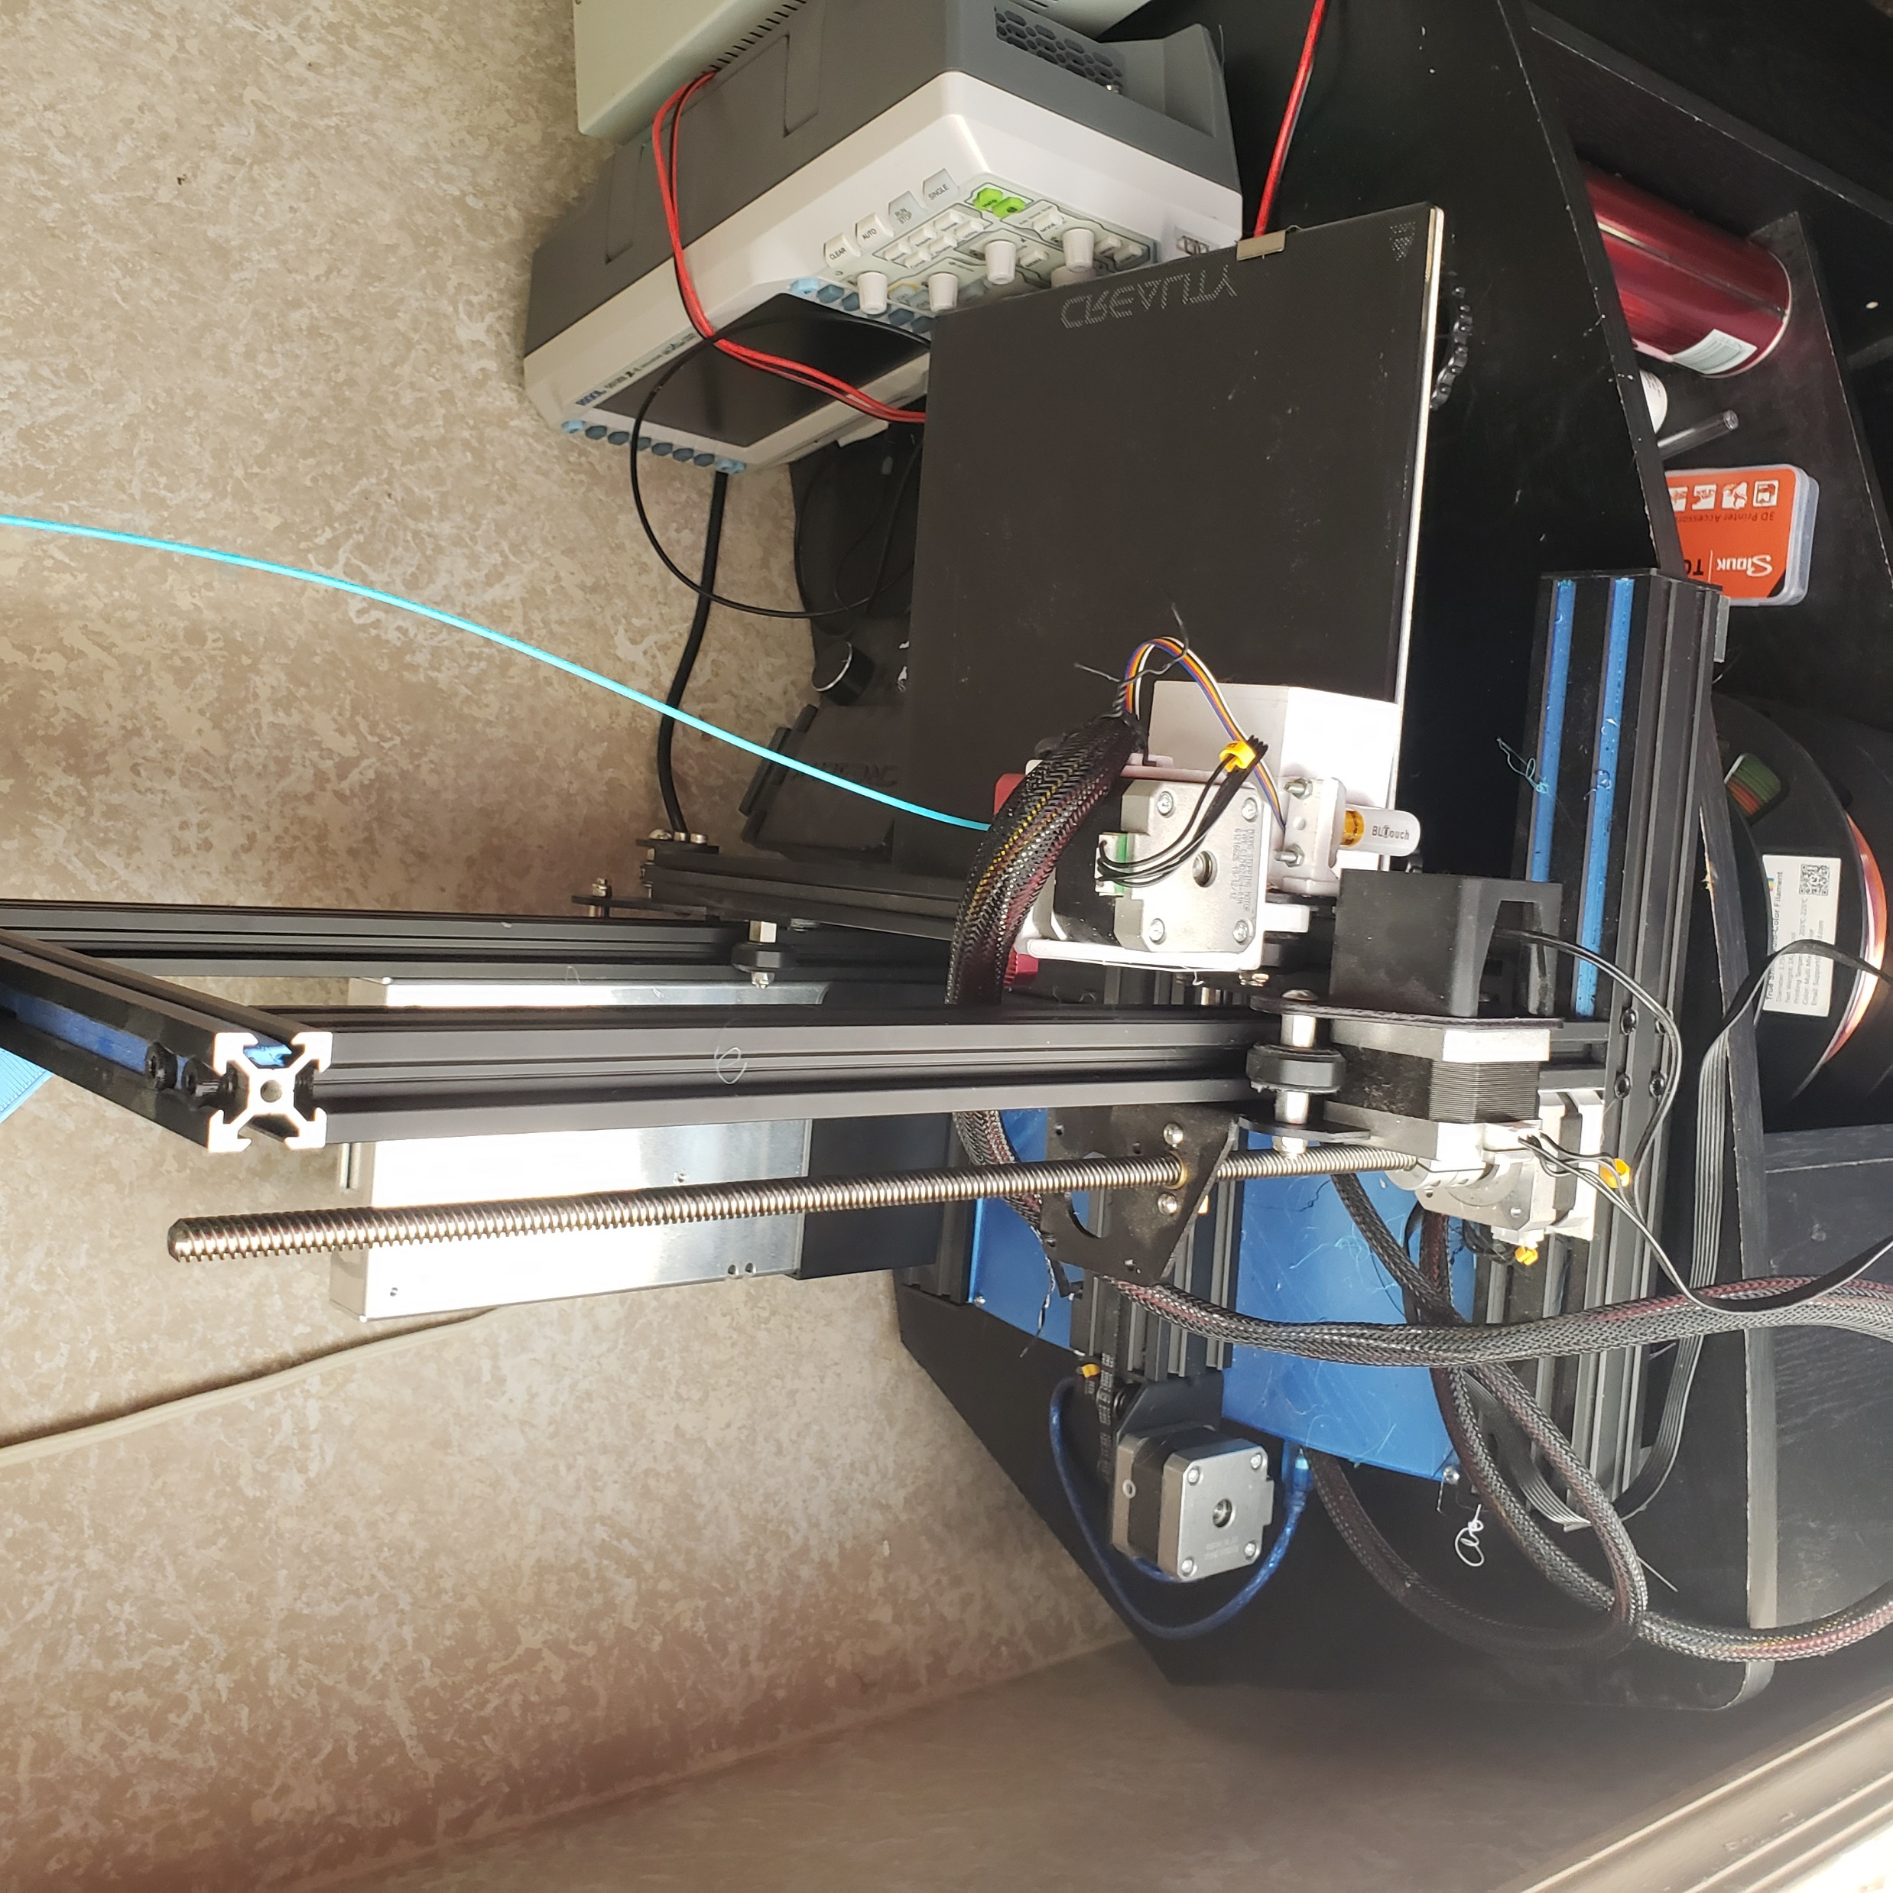
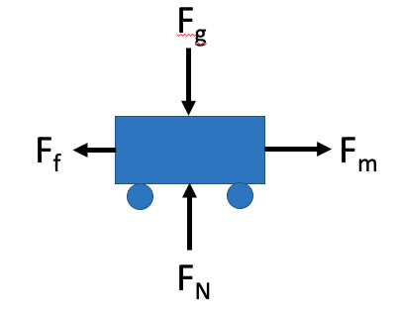
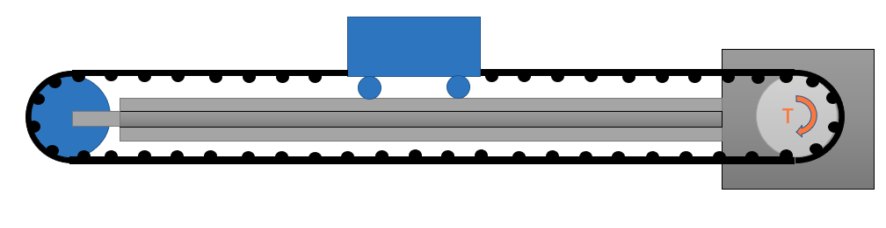
Initial Concept Generation
Cartesian system
Belt/pulley combination with counterweight for Z-axis
Fail-safe latches at top and bottom of printer to prevent bottoming-out
Mount motors outside heated chamber, cool other motors with Peltier Plates
Space heater heating element
Surrounded by insulation

Slide 6
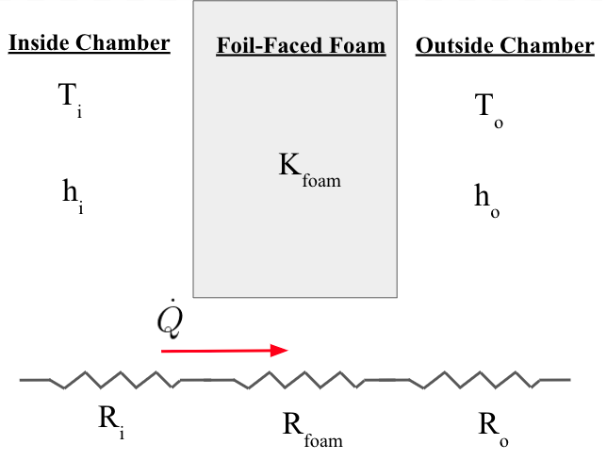
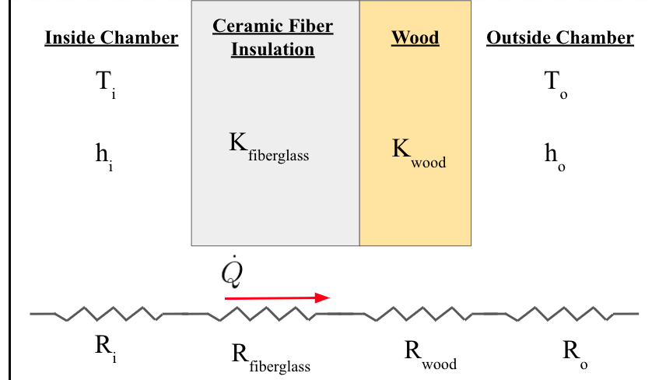
Preliminary Thermal Analysis
Method 1
Method 2
3”
1”
¼”
Cons
Flaky
Bulky
Pros
Less Volume
Sturdy
Clean
Cons
Worse Insulator
Pros
Better Insulator (larger thickness)

Slide 7
Next Steps
CAD Frame and Components
Assemble movement system in frame
Build Z-axis movement mechanism
Design belt tensioning mechanisms
Get working 3D printer without build chamber
Perform more complete thermal analysis on heating element

